Slide 1


超级开发信

Slide 2
开发信的最最最主要的目的-得到客户回复
开发信的弊端：
1、打开率低
2、回复率低
3、质量不高（造成上面两个现状的原因）
能让客户回复的三个点：
1、天时：市场优势，产品优势，时势优势
2、地利：实际距离与虚拟距离
3、人和：用心, 创意，坚持

Slide 3
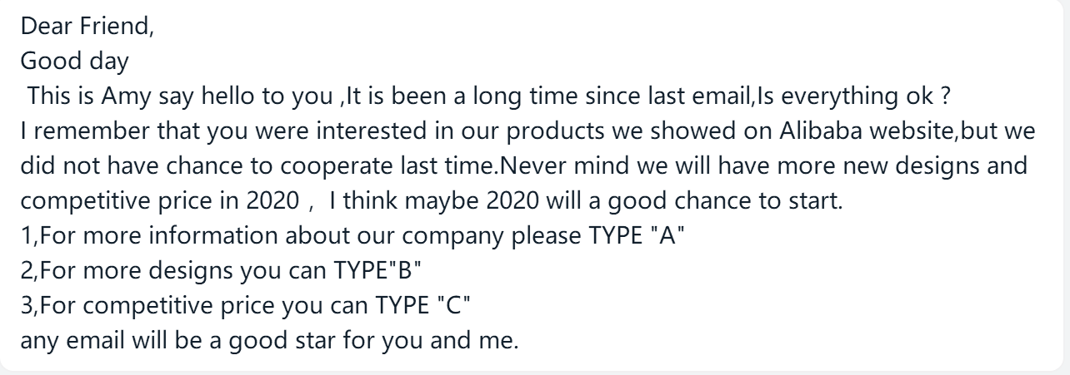
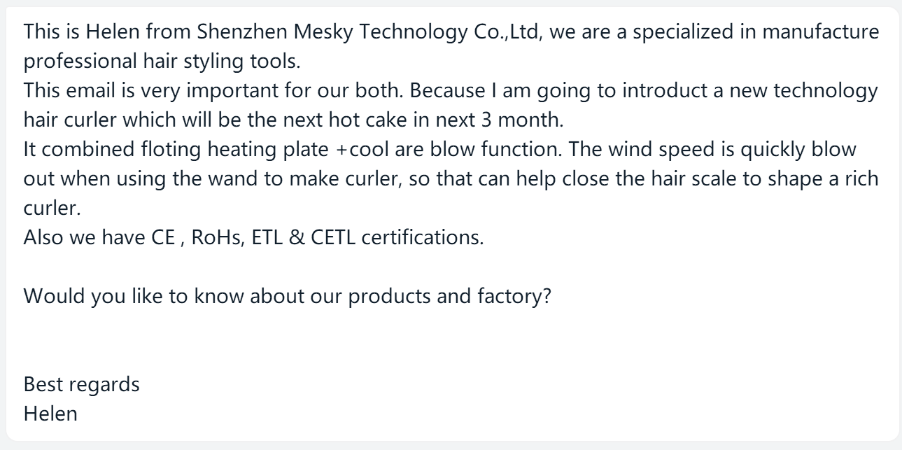
低质量开发信

Slide 4
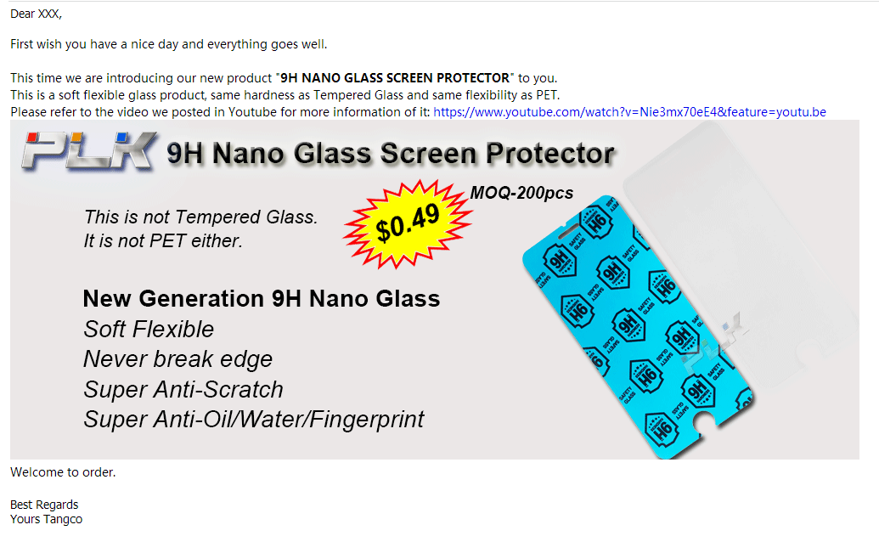
最“常规”开发信

Slide 5
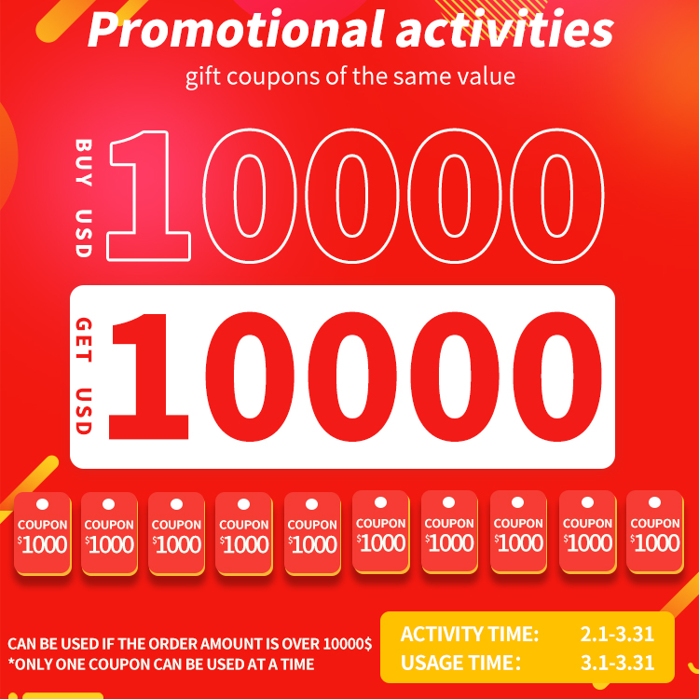
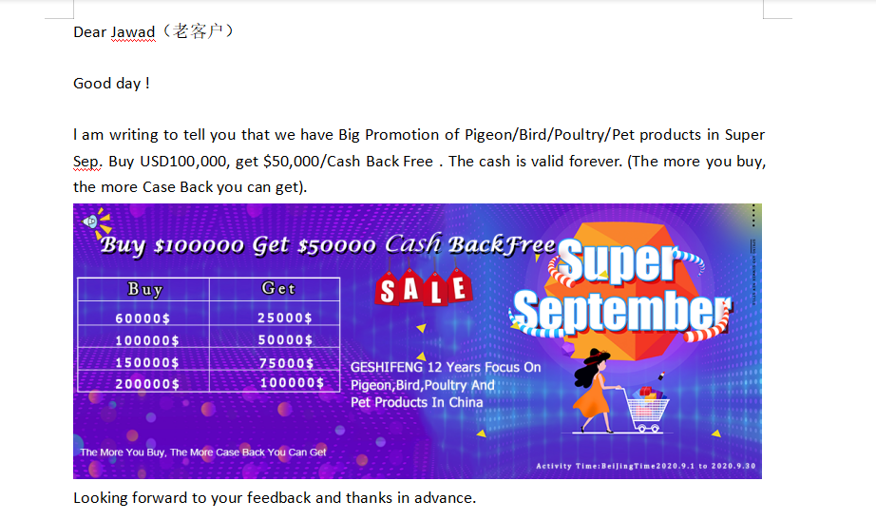
采购节开发信-激活沉睡客户

Slide 6
采购节开发信-激活孤儿客户
Dear Xxx, Wish you have a nice day and everything goes well. Today our company held a meeting of our VIP customers in the past 5 years, sure you were one of them. The purpose of our meeting is mainly trying to feedback our old customers in our xxxth anniversary celebration, especially the one like you who helped us a lot in our most difficult time, your help would be recorded in our company big history event. As per our transaction record, you placed total around $xxx to our company in the past xxx years/months, our company would love to feedback you $xxx(总金额的1/10左右，取个总数). So if you are still interested in our products like xxx, xxx, xxx please reply my email so that we can have the further communication. Looking forward to your kind reply. Best Regards Yours Xxx. 不用怕，送的金额就在客户将来的新订单里面每次给客户抵扣10%左右就行了（心态放宽一点就好了，因为不下单的客户就不是我们的客户，现在我们在我们竞争对手那里抢饭吃）

Slide 7
开发信-利用天时-1
Dear Xxx, （不要用Hi或Hello，保持专业，名字首字母一定要大写）
It is my honor to write an email to you for potential business opportunities about our products xxx.
This is xxx from xxx Company, which is a professional manufacturer of xxx products with more than 20 years experience.
一句话做出简短的公司介绍，人，公司，厂家，产品，年限
We are the first one who developed this product xxx, (we are also the only one who can supply you both of the PATENT and FDA Certificate, 这句话如果有这些东西的话就加上), please refer to attachment for the detailed information of it.
或：We are the first and only one who gained the order from brand customer (Warmart或其它知名品牌） about our product xxx.
以新品（如有专利或其它认证提供更好）或是合作品牌来吸引客户
Now it has huge potential market, if you have any interests in it, please never hesitate to let me know, thank you very much.
告诉客户这个产品的庞大市场吸引客户
Looking forward to your kind reply!
Best Regards
Yours Xxx

Slide 8
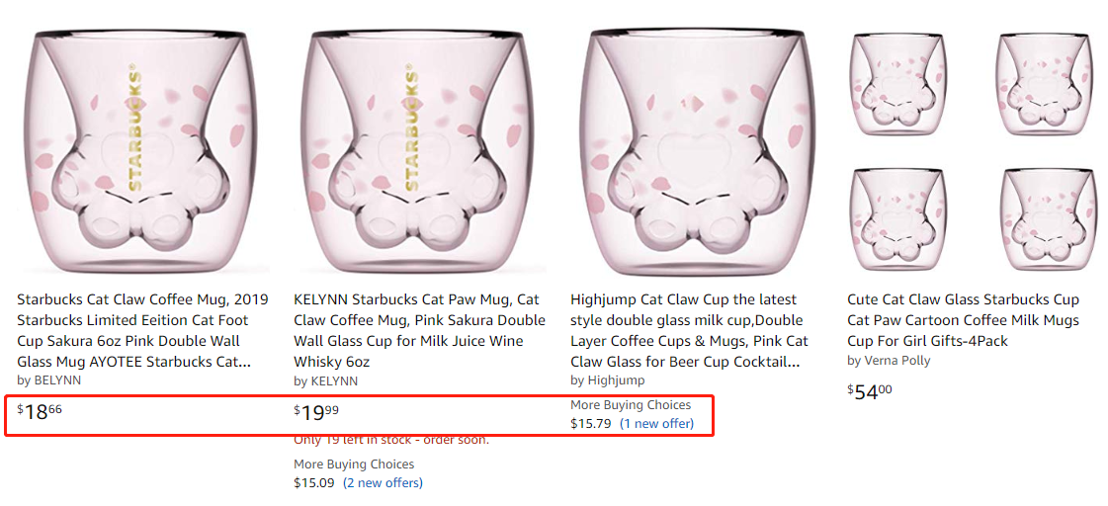
开发信-利用天时-2
Dear Xxx,
It is my honor to write an email to you for potential business opportunities about our products xxx.
This is xxx from xxx Company, which is a professional manufacturer of xxx products with more than 20 years experience.
Now we have successfully developed the new hot products (Cat Claw Cup) with only 1/3 cost of the original one, if you have any interests in it please never hesitate to let me know, thank you very much.
（新品加比原装价格便宜2/3来吸引客户）
Best Regards
Yours Xxx

Slide 9
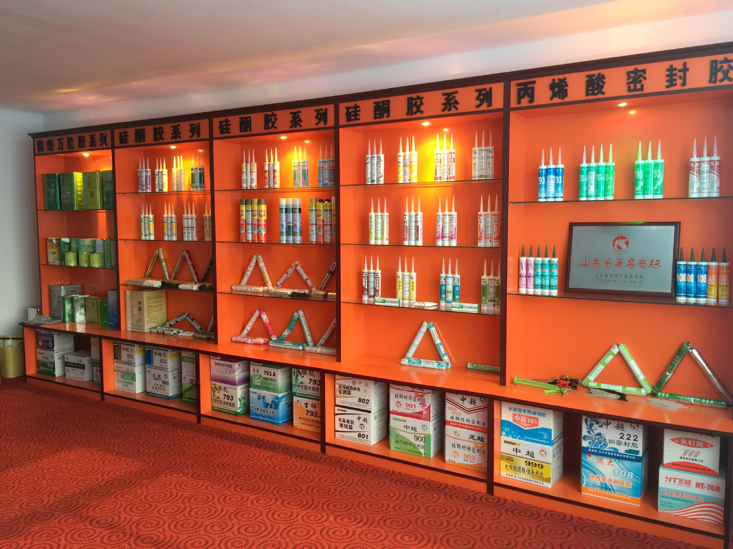

开发信-利用地利-2
Dear Xxx,
It is my honor to write an email to you for potential business opportunities about our products xxx.
This is xxx from xxx Company, which is a professional manufacturer of xxx products with more than 20 years experience.
As the supplier of one of the biggest customer (xxx Hotel) in your country (利用客户的酒店图片或是公司图片来促进，记得要P上自己的LOGO更具有杀伤力）, I do believe I should have the whole product solution to meet your needs in the Hotel Products, if you have any interests in this business, please reply so that we have have a further communication on how to make it happen.
Looking forward to your kind reply!
Best Regards
Yours Xxx

Slide 10
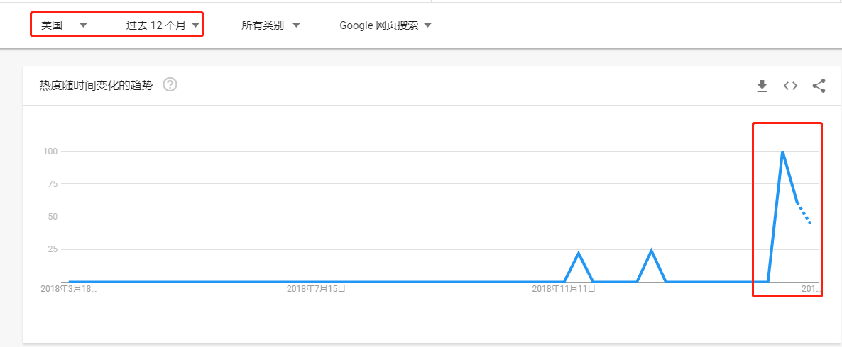
开发信-利用地利-3
Dear Xxx,
It is my honor to write an email to you for potential business opportunities about our products xxx.
This is xxx from xxx Company, which is a professional manufacturer of xxx products with more than 20 years experience.
According to the data from Google Trend, our products xxx is starting to be a trend product in your country, please refer to the attachment for the picture of it so that you would have a better idea.
So if you have any interests in it please just feel free to contact me for more information, thank you very much.
Best Regards
Yours Xxx.

Slide 11
开发信-利用人和-1
Dear Xxx,
It is my honor to write an email to you for potential business opportunities about our products xxx.
I got your contact information from one of my friends in Germany who is doing xxx product, he recommended you to me.
利用这种客户推荐方式取得客户初步信任
This is xxx from xxx Company, which is a professional manufacturer of xxx products with more than 20 years experience.
If you have needs in the near future of our products, I can send you our detailed information for reference, sure I can also offer you the free samples for quality testing.
If you can offer me your detailed requirements would be very helpful for me to offer you the quotation for reference.
利用免费样品吸引客户（可以从运费上平衡产品价值）
Your reply would be highly appreciated.
Best Regards
Yours Xxx

Slide 12
开发信-利用人和-2
Dear Customer,
It is my honor to write an email to you for potential business opportunities about our products xxx.
This is xxx from xxx Company, which is a professional manufacturer of xxx products with more than 20 years experience.
According to the data from Amazon (Wish, eBay...), now our product can help you to have at least 500% profits if you buy this product from us.
Sure we can offer you the (free) samples for quality testing.
直观告诉客户庞大的利润空间吸引客户及能给客户提供样品测试
If you have any interests in it please just feel free to contact me so that we have have detailed communication of it.
Looking forward to your kind reply.
Best Regards
Yours Xxx.

Slide 13
总结：
开发信的回复率有多高取决于你对这封开发信的用心程度有多深

Slide 14

谢谢观看

